Slide 1
Team Members
Devarshsinh Mahida djm746
Shivam raval sgr341
Mohit patel msp552
GLOBAL SURFACE SUMMARY OF THE DAY – GSOD data ANALYSIS for rain prediction

Slide 2
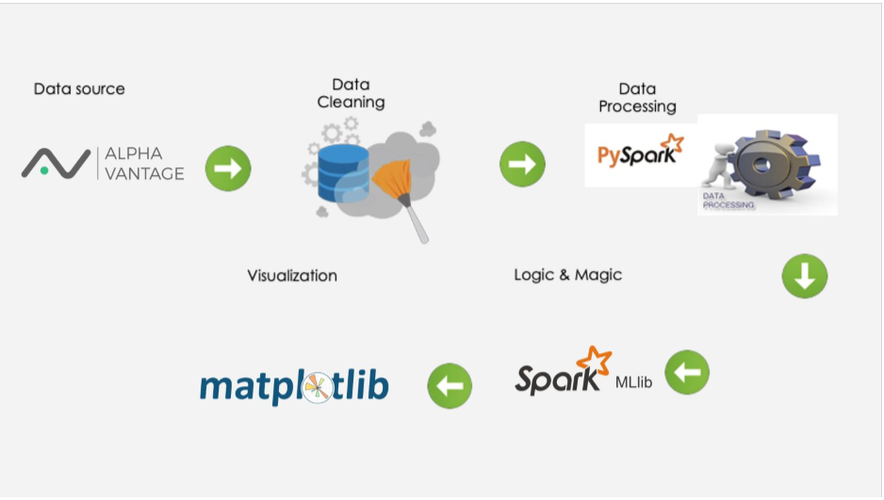


ARCHITECTURE

Slide 3



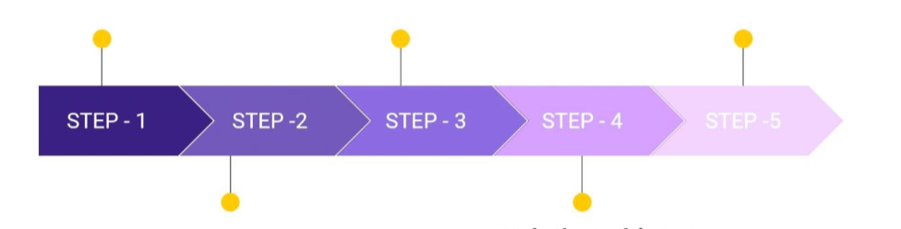


Made the model more scalable using Pyspark (20 Million Records)
Identified the GSOD Dataset for our analysis
Visualize the data with respect to trained data
Cleaned the Data to get the required features by using data frames
Using Logistic Regression and Decision Tree Classifier, predicted occurrence of rainfall

Slide 4
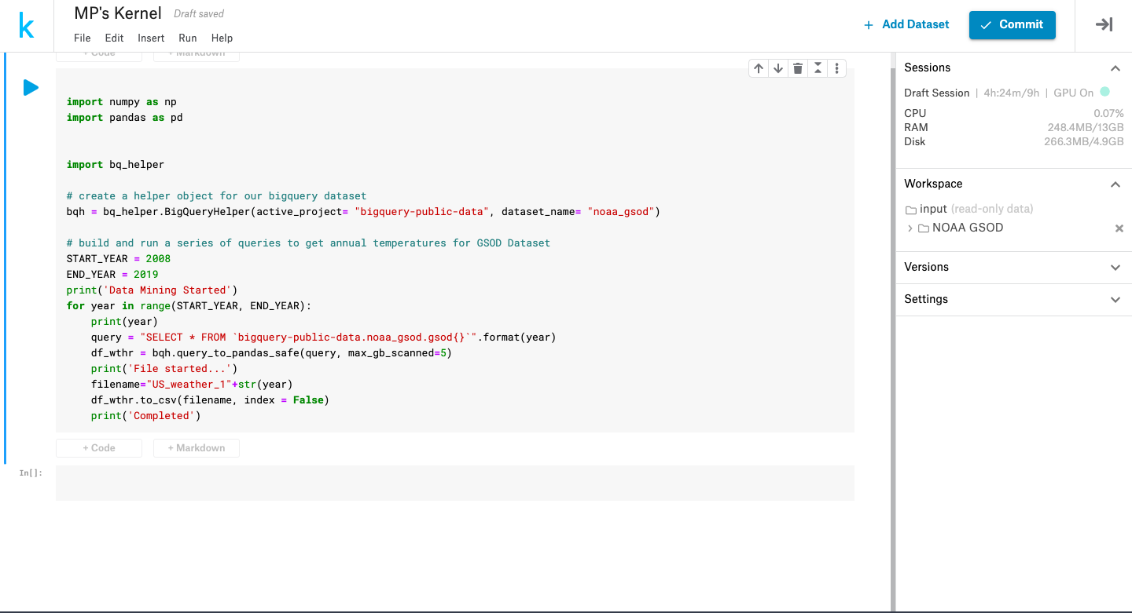
Extracting Data From Kaggle

Slide 5
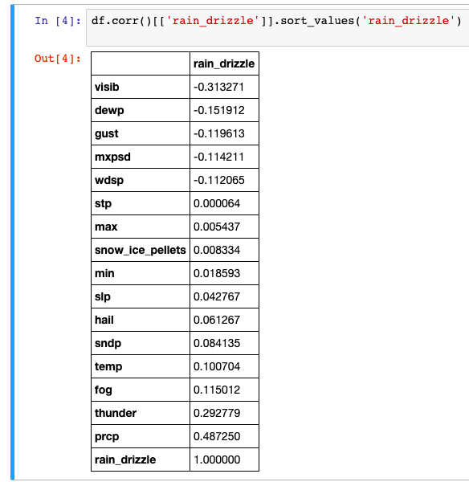
Feature Selection

Slide 6
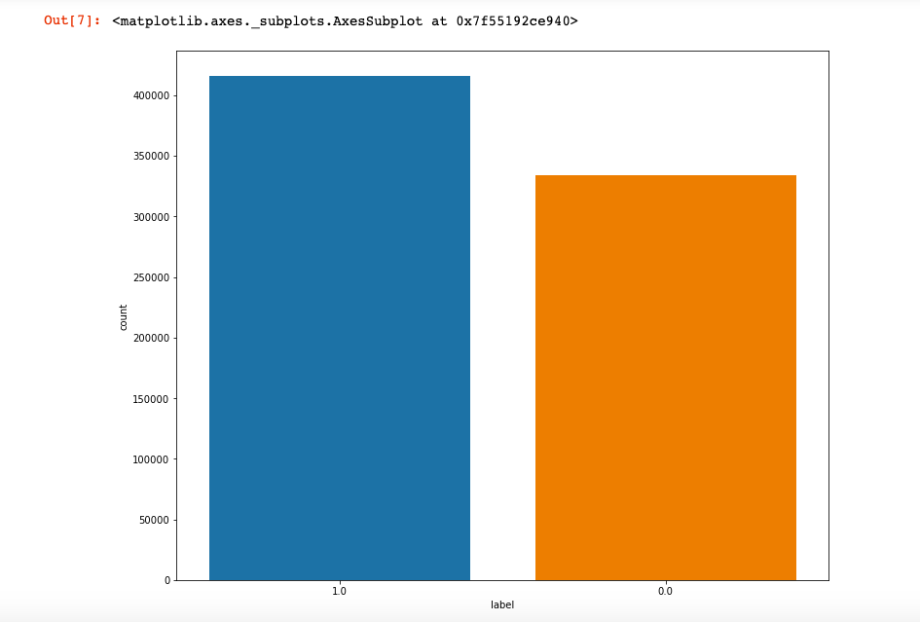
Running locally on small dataset (0.75 Million)

Slide 7
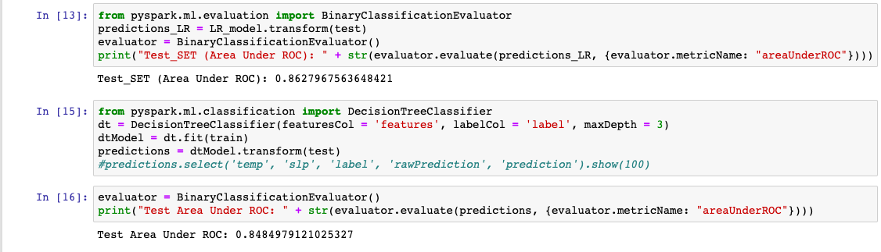
Running locally on small dataset (0.75 Million)

Slide 8
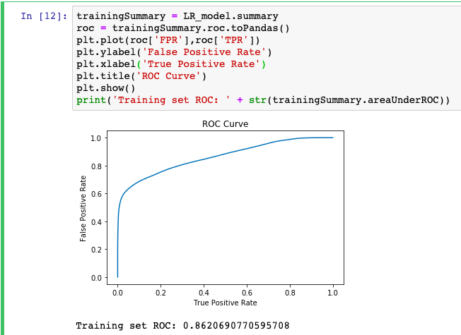

Slide 9
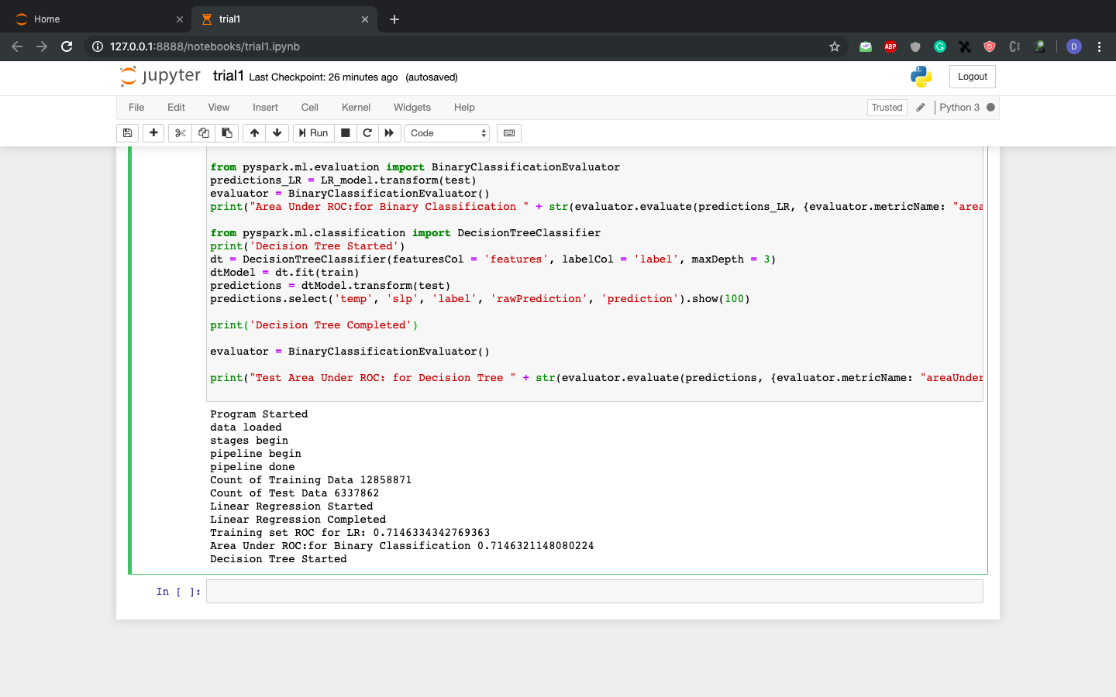
Running locally on 20Million Records
Runtime : more than 1 hour

Slide 10
Running on dumbo cluster

Slide 11







Running on dumbo cluster
Worker Node
RAM: 2/4 GB
Rainfall Prediction
Master Node

Slide 12
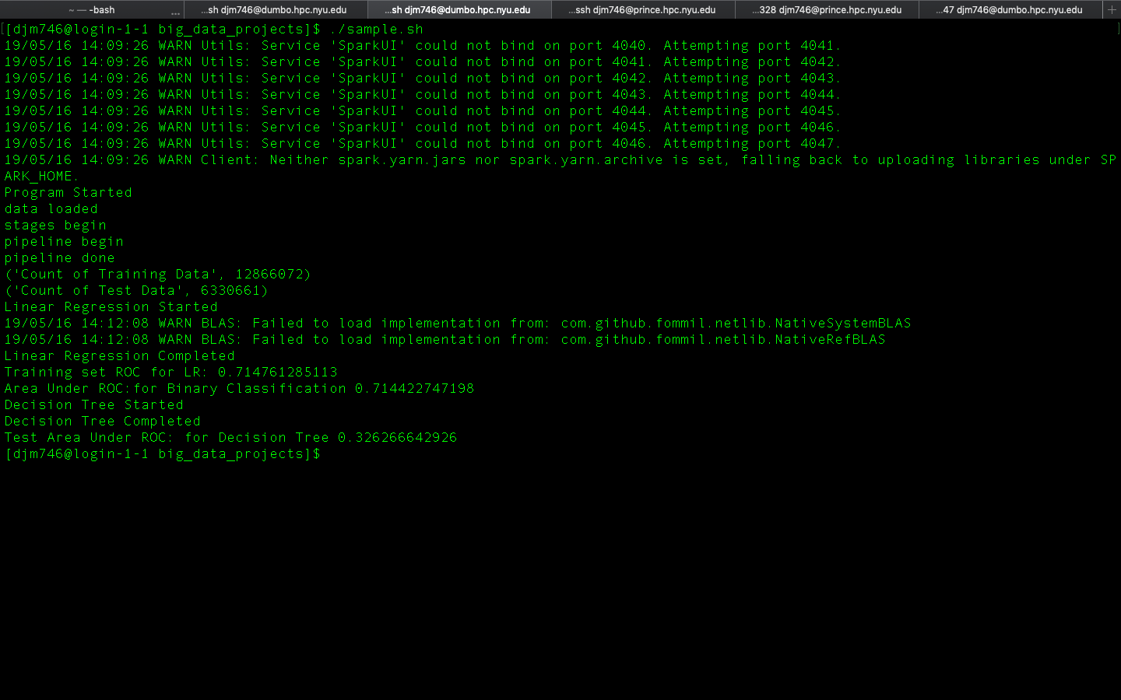
Accuracy

Slide 13
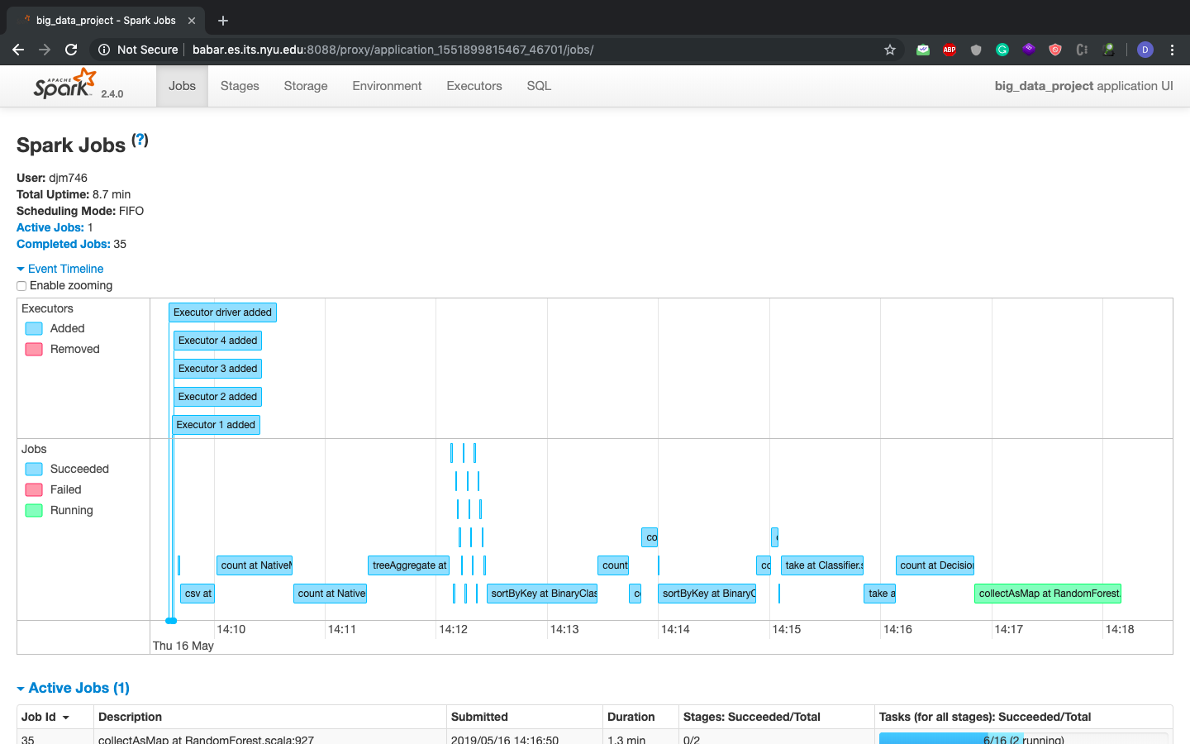
Runtime : 10 minutes

Slide 14
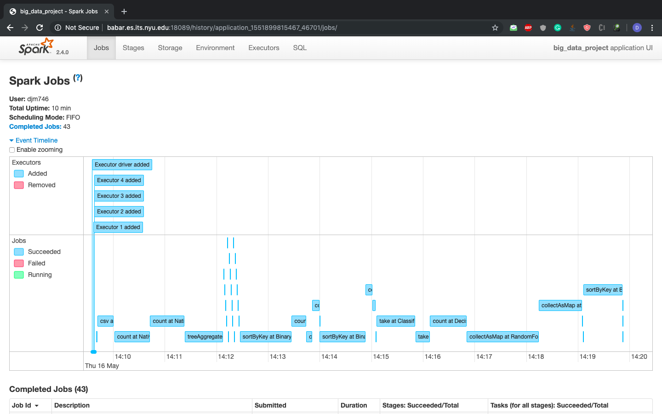
Runtime : 10 minutes

Slide 15
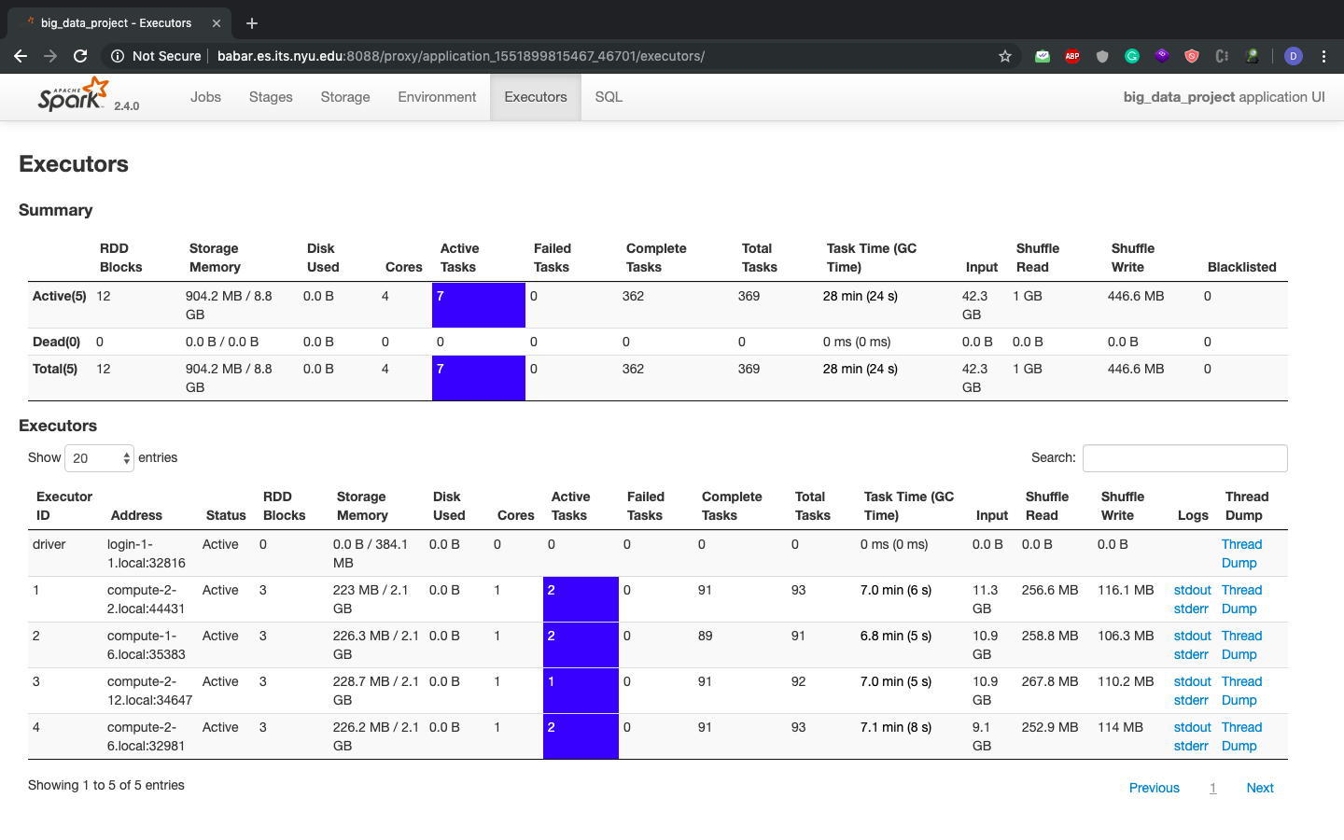
executors

Slide 16

1.Log into Nyu vpn
Steps to run on dumbo cluster

Slide 17
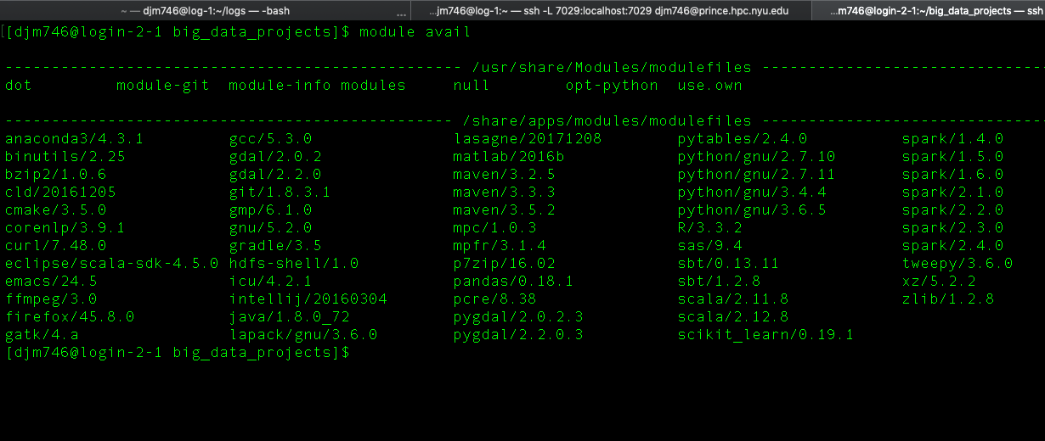
2. Check the available modules

Slide 18
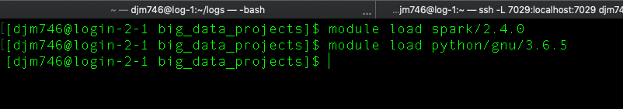
3. Load the spark module

Slide 19
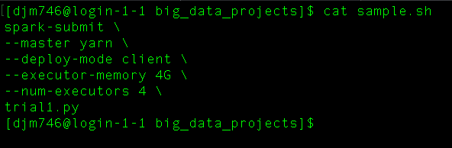
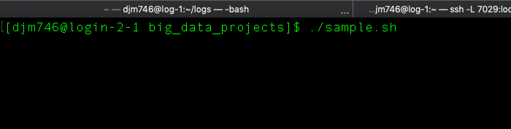
I have created a shell script for spark-submit command.
Run the shell script.
4. Run spark-submit command

Slide 20
Thank you

